Slide 1
Spring 2024 Updates on ROMS Study Abroad Advisory Committee
Charge:
Assist Study Abroad and Undergraduate Advisors to assess current study abroad programs and review proposals for new programs; ensure that programs serve ROMS majors and minors; help inform faculty about ROMS study abroad opportunities and promote our programs to students; streamline the credit transfer process for courses across the Romance languages; **integrate UNC courses abroad into the IDEAS in Action curriculum**.
Members 2023-24:
Martha Alexander, Elizabeth Bruno, Amy Chambless (Study Abroad Advisor for Italian), Dorothea Heitsch (Chair, Study Abroad Advisor for French), Pello Huesa, Gosia Lee, Jo Lindquist (Study Abroad co-advisor for Spanish), Abel Muñoz-Hermoso (Study Abroad co-advisor for Spanish), Cécile Ruel, Richard Vernon (Study Abroad Advisor for Portuguese), Daniele Meregalli (GTF), Angela Gatto (GTF).

Slide 2
Overview of SAOC Projects 2022-24
Reviewed several program proposals.
Compiled lists of all study abroad programs within the language sections to be used for advising purposes; these lists will be updated regularly and sent out to all ROMS instructors at the beginning of each semester.
Decided to have one meeting per semester between the ROMS Study Abroad Advisory Committee and one program director + one transfer specialist until it is clear how the pre-approval process and database works (and to simply touch base).
Recommended that resurrected programs, new programs, or new SA courses should go through the ROMS SAAC because bypassing this process may cause stress for advisors, especially in Spanish, when they find out that courses / programs don't correspond to UNC standards.
Developed a proposal for study abroad teaching assignments.

Slide 3
SAOC Projects 2022-24 (details)
Program Proposals:
SPAN 344 Summer in Peru 'Pre-Columbian Cultures and Civilizations of America’
plus SPAN 301 (Hélène de Fays).
ITAL 101 Maymester study in Italy (Gosia Lee).
Summer in Bogotá, Colombia, for students pursuing the Legal Professions track in
the Spanish Minor (Hosun Kim); potential graduate exchange.
Note: Any colleague in ROMS may propose a faculty-led or other program to the Study Abroad Office; but please run your proposal by the SAOC before you do so.
Faculty Rotation for Teaching Programs Abroad:
All ROMS Faculty are invited to discuss, comment, and vote on the proposal by a date tbd.
Credit Transfer Process:
In Spanish, Abel Munoz, Jo Lindquist, and Liz Bruno are responsible for transferring credits of returning students, for approving new courses for transfer, and for populating the pre-approval database; so are Amy Chambless, Dorothea Heitsch, and Richard Vernon for Italian, French, and Portuguese.
The overall length of the credit approval process can take between one and eight months.

Slide 4
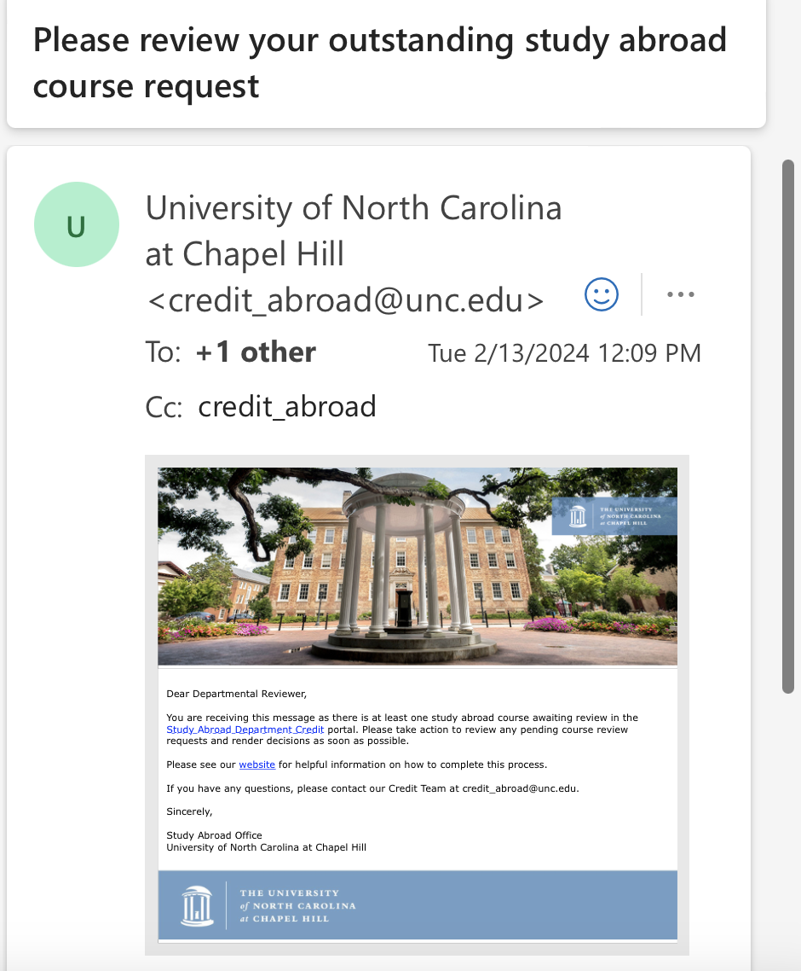
Study Abroad pre-approval Database example: Weekly Reminder for Study Abroad Advisors

Slide 5
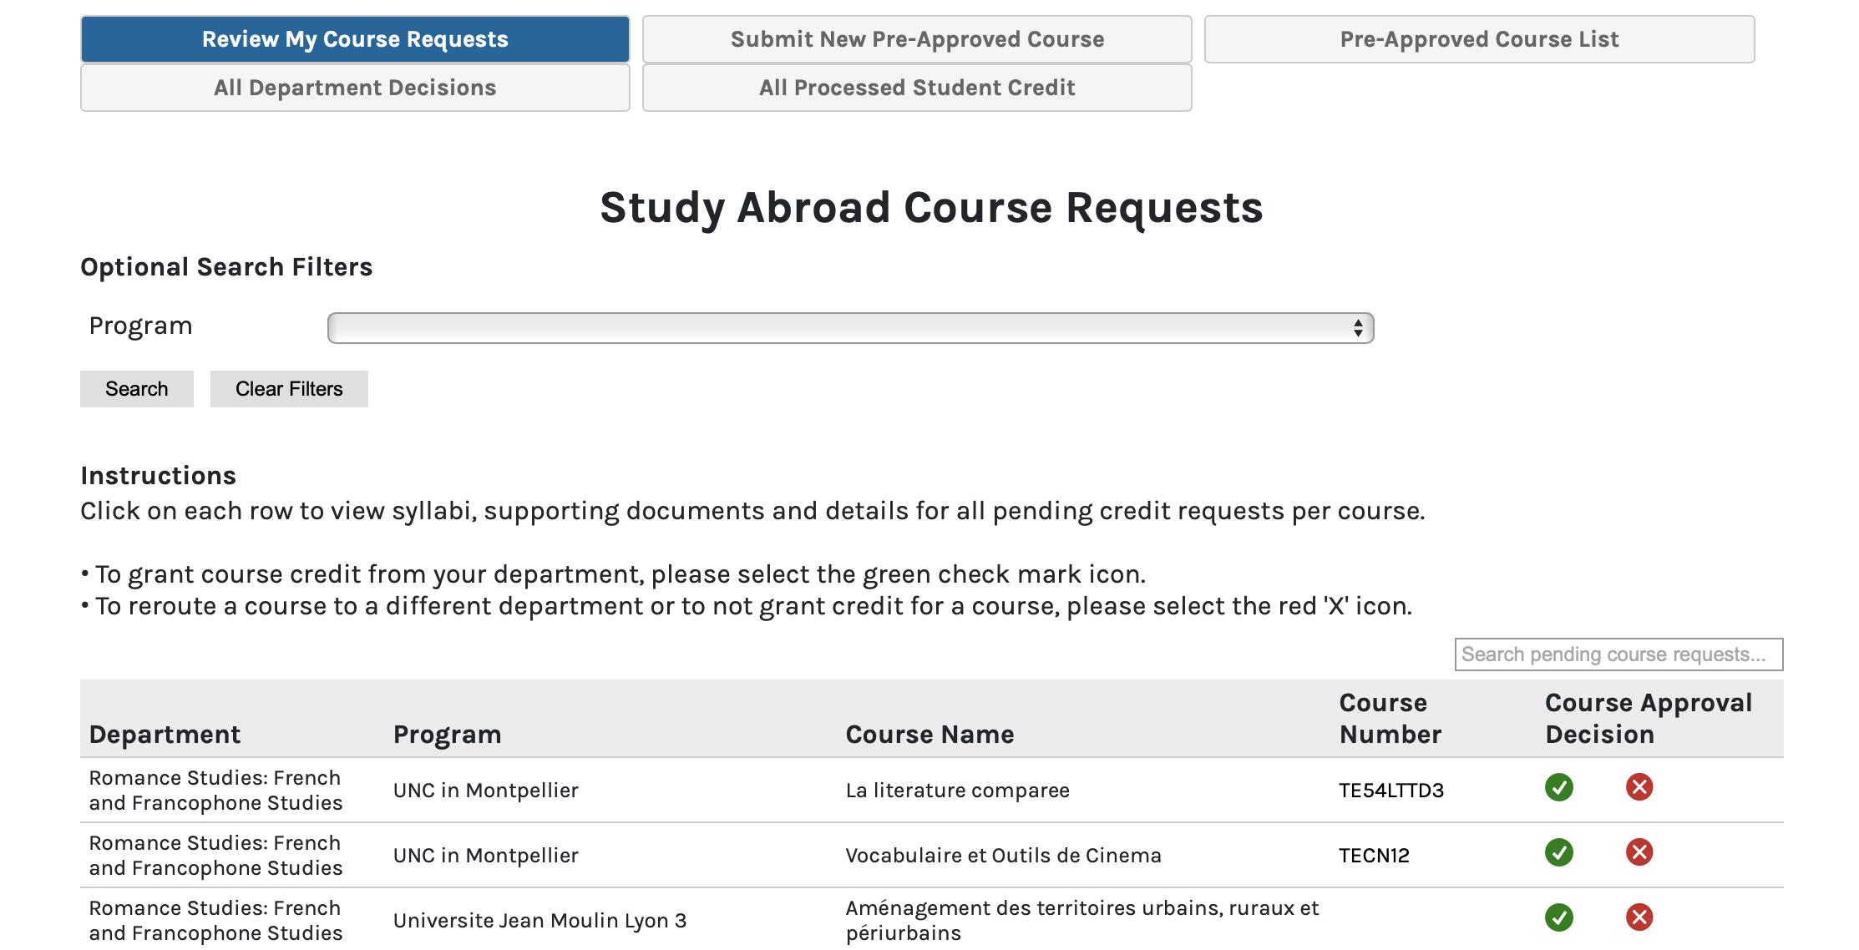
Study Abroad pre-approval Database example: course transfer requests for French (partial list)

Slide 6
How about an alternative to studying abroad?

Slide 7
COIL Curriculum Development Awards
https://global.unc.edu/programs/coil/coil-2/
Faculty from any UNC-Chapel Hill department or school are eligible for a $2,500 curriculum development award for COIL. The funds are disbursed as an overload payment in compensation for time developing and implementing COIL activities. If a course is co-taught, the award will be split between the faculty members.
Faculty may request an additional $1,500 award to fund graduate student support (student does not need to be identified at time of application).
The next deadline for new COIL courses is April 5, 2024 for Fall 2024 or Spring 2025 courses. Applications may be submitted at any time and are reviewed shortly after the deadline.

Slide 8
STUDENT BENEFITS
COIL courses benefit students by:
reducing many traditional barriers to global education by connecting students to virtual opportunities
enabling cultural self-awareness and fostering globally mindfulness through direct engagement with international peers
providing the opportunity to engage in meaningful, transformative, and collaborative work through the use of digital technologies
exposing students to and helping them to engage with different, global perspectives on their discipline or subject area
promoting their intercultural communication and competency skills through cultural exchange and guided projects
FACULTY BENEFITS
For UNC-Chapel Hill faculty, the benefits of a COIL are endless and, for many, may mark the beginning of long-term international collaborations. Faculty will benefit by:
collaborating with a colleague abroad on a project that meets both of their course objectives
finding creative and innovative ways to engage students with existing or enhanced materials and technologies
fostering and developing new collaborations and partnerships
learning how to effectively incorporate global themes into existing courses
expanding virtual education skills and competencies
enhancing cultural competencies through the administration of students in different countries
participating in a collaboration that can serve as professional and international development
potentially attracting new students to their courses and departments
PARTNER FACULTY BENEFITS
International faculty partners benefit from a COIL collaboration by all the above-mentioned benefits and by:
developing and strengthening relationships with a top-rated R1 university in the United States
learning about different educational systems and approaches
engaging students with new, global peers and new technologies and resources
gaining access to resources and libraries in their partner institution
GRADUATE STUDENT BENEFITS
Graduate students that support COIL faculty benefit by:
gaining unique and valuable experience in developing and implementing an international collaborative project
furthering existing research or topics of interest
developing relationships and networks with faculty at UNC-Chapel Hill and abroad
receiving support from an external unit

