Slide 1
Using Music in the Classroom to Build Community and Promote Engagement
Elizabeth Tolman

Slide 2
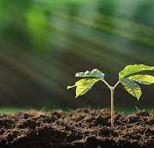
Farmers know that their most important crop is their soil. For a teacher, the spirit of community in the classroom is the soil; without it, the “crop” (students’ production of the language) is much poorer.
Building community in the classroom is essential because it helps to lower the affective filter first described by Stephen Krashen by decreasing anxiety (we are among friends), increasing motivation (class is fun!), and increasing self-confidence (we are all in this together and can take risks without fear of standing out).

Slide 3
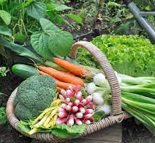
Once community is developed, teaching becomes much easier. Students participate more, skip class less often, form study groups outside of class, produce higher quality work, and ultimately, learn the subject material much better.

Slide 4
Songs can be integrated into the classroom in many different ways.
To build vocabulary
To reinforce grammar
To enhance cultural lessons
Ideally, they are used for all three.

Slide 5
Choosing a song
Think about what your objective is (vocabulary, grammar, culture, or purely to entertain). Use google and search “Songs about food” or “Songs that use por and para” or “Songs about Barcelona”.

Slide 6
The second unit in SPAN 203 is about sports. A quick google search for “Spanish songs about sports” didn’t give too many leads, but searching for “Songs about Messi” was a goldmine.

Slide 7
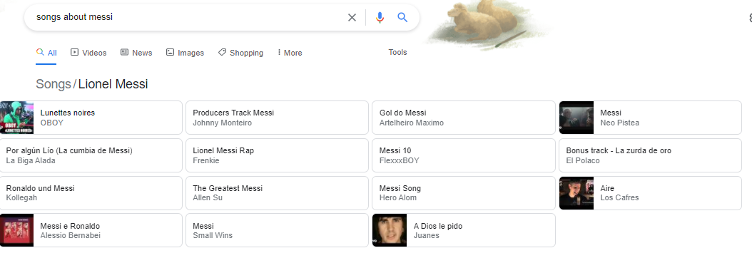

Slide 8
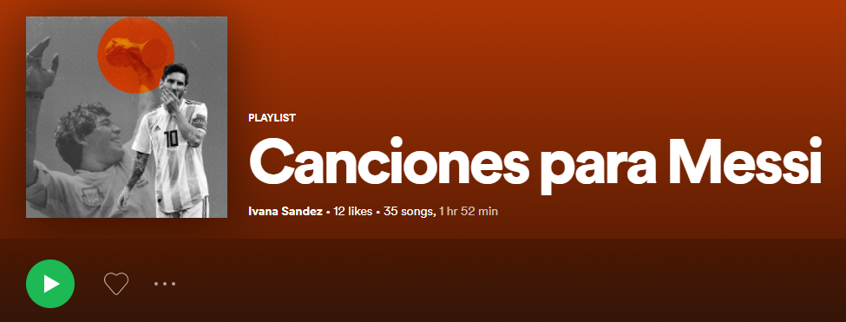
There is even a Spotify playlist of 35 songs about Messi! The songs range from salsa and rock to rap and cumbia.

Slide 9
Chapter 2 contains sports vocabulary, a review of formal and informal commands, an introduction to the subjunctive, and cultural tidbits about famous athletes. By choosing a song about Messi, I was able to tap into their existing knowledge about sports (and Messi, as most students are familiar with him) and integrate that with a lesson on vocabulary and grammar.
I start the lesson by asking them to name the most famous athletes they can think of. I then google “Songs about Serena Williams / LaBron James” (etc.). Very few results come up. Most of the songs contain lyrics that mention the athletes but are not about them. Then I show the google search about Messi and the Spotify playlist. There is stunned silence in the room.

Slide 10
Dale campeón, esta fiesta es tuya de tu gran valor, ya no quedan dudas vaya esta canción por tantos momentos de felicidad, que nos da tu esfuerzo
En cada paso, en cada acción detrás sabemos un montón* *mucho de corazones compartiendo el sueño
para vivir esta emoción, para cantar esta canción sólo hace falta contemplar tu genio* *inteligencia
Messi... oh Messi siempre contigo Messi... oh Messi gracias amigo!
ooohh... ohhh...

Slide 11
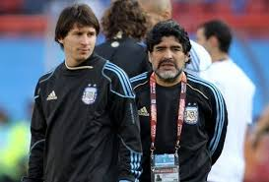
Leonel Messi y Diego Maradona (que murió en noviembre de 2020) son los futbolistas más famosos del mundo. Además, Messi es el atleta más rico y celebrado del mundo. Hay una lista de canciones sobre Messi en Spotify y vamos a cantar una canción sobre él en clase. Escriban un diálogo de por lo menos ocho frases entre los dos en el cual Maradona le da consejos a Messi y Messi le hace preguntas a Maradona. Usen por lo menos seis verbos en el subjuntivo.
Pueden discutir el fútbol, la fama, la vida familiar u otra cosa.

Slide 12
In SPAN 203 and 204, I use Marc Anthony’s Vivir mi vida on the first day of class. In SPAN 105, I use it when we cover the ir + a + infitive (a way of expressing the future).
Making students sing on the first day of class gets them out of their comfort zone and forces them to participate.
At the end of class I have students rewrite the lyrics. Each group reports back and the class votes on the best lyrics. We all sing the new lyrics together.

Slide 13
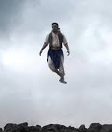
In SPAN 204, I use the song Gaucho power to talk about the gaucho as a cultural symbol of Argentina.
This song is somewhat ridiculous, and it’s a great way to open the discussion to deep questions of national identity. I start the class by asking them to identify national symbols for the US (bald eagle, McDonalds, cowboys, and the White House usually come up). After watching the song, we discuss the song’s attitude toward the gauchos: is it making fun of them or of the worship of them? Do we have equivalent songs in English?
At the end of class, I ask the students to write a dialogue as if they were on a job interview (the theme of the chapter). One person is a gaucho, the other is the interviewer. Hilarity ensues.

Slide 14
Using songs in the classroom is a terrific way to integrate vocabulary, grammar, and culture. Perhaps most importantly, it’s a wonderful way to build community.

