Slide 1
Program Alignment for Changing Curricular Needs
ROMS Lightning Workshop March 23, 2022
Dorothea Heitsch, PhD Teaching Professor in French & Francophone Studies Undergraduate & Study Abroad Advisor in French

Slide 2
French & Francophone Studies
1st year seminars: La mode, Déjà vu
research intensive
FREN 150 core course for Global Studies
aligned with IAAR-SLATE, QUEP, COIL
FREN 186 core course for Food Studies
FREN 204 bridge course between GenEd and FREN major/minor
FREN 255, 260, 262
FREN 300 sole requirement for FREN major/minor
7 electives, many of which are aligned with new Focus Capacities

Slide 3
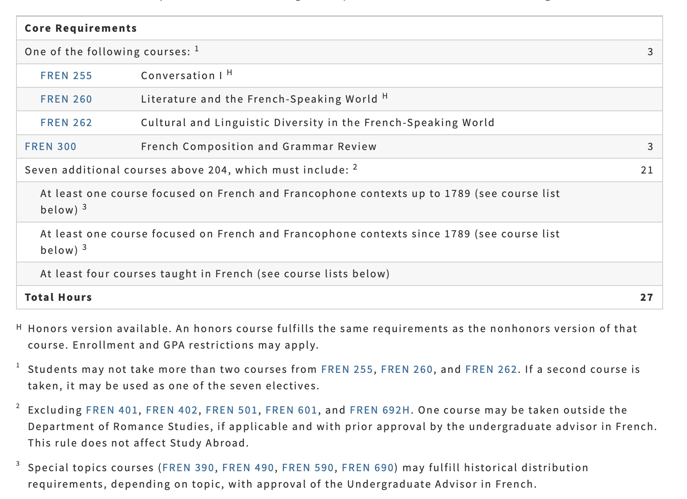
FFS Major Requirements
Notes:
https://catalog.unc.edu/undergraduate/programs-study/romance-languages-major-ba-french-francophone-studies/#requirementstext

Slide 4
FFS Minor Requirements
Notes:
https://catalog.unc.edu/undergraduate/programs-study/french-minor/#requirementstext

Slide 5
New Courses
FREN 305 Healthcare in France and the Francophone World
FREN 501 French for the Health Professions
FREN 288 Francophone Caribbean Literature in Translation
FREN 436 Currents in Caribbean Literature
FREN 326 Cultures of Resistance in the French-Speaking World
FREN 379 Environment, Society, and Public Policy in Southern France (*taught in UNC Summer in Montpellier)

Slide 6
Updating the FFS Program
three-year plan
regular internal program reviews
course scheduling meetings or discussions
integrating curricular preferences of new hires
revitalizing study abroad within and beyond ROMS
2021-2022 Transatlantic Mobility Grant jointly sponsored by The Cultural Services of the French Embassy in the U.S., together with NAFSA, the FACE Foundation, and support of the U.S. Embassy in France, and UNC-Chapel Hill.

Slide 7
Learning, Teaching, and Curriculum
Curriculum and curricular innovation*
Program-level learning outcomes and assessment-- how well do course learning outcomes map onto program learning outcomes?
Study abroad
Percentage and kinds of courses offered online; future prospects for online delivery of courses and/or programs
*Is the curriculum current? Are courses relevant?
Scaffolding: How do humanities classes build on each other? How is progress articulated? How coherent are the curriculum and the major?
Global learning, Undergraduate research
Support for pedagogical development of faculty and teaching assistants
Interest in and/or support of experiential learning, public humanities, community engagement, and other current pedagogical practices
Career education for undergraduate students and internship opportunities
Relationship between and among "tracks" within the majors or minors especially between creative writing / rhet-comp / linguistics / languages for the professions on one hand and the literary, cultural, and historical courses on the other hand
Where does departmental curriculum intersect with GenEd? Who teaches these courses, and how is that responsibility distributed?
What is the time to degree for majors? Credits required to complete the program(s) as compared to other majors at the institution
How does the department support students who have accommodations? Does the department feel supported by the institution in its efforts to teach a broad range of learners?
How is the curriculum represented on the department website?
Notes:
Adapted from January 2022 Certified Program Reviewer workshop at MLA Convention.

