Slide 1
Project-Based Learning in language and culture course
Spring 2022

Slide 2
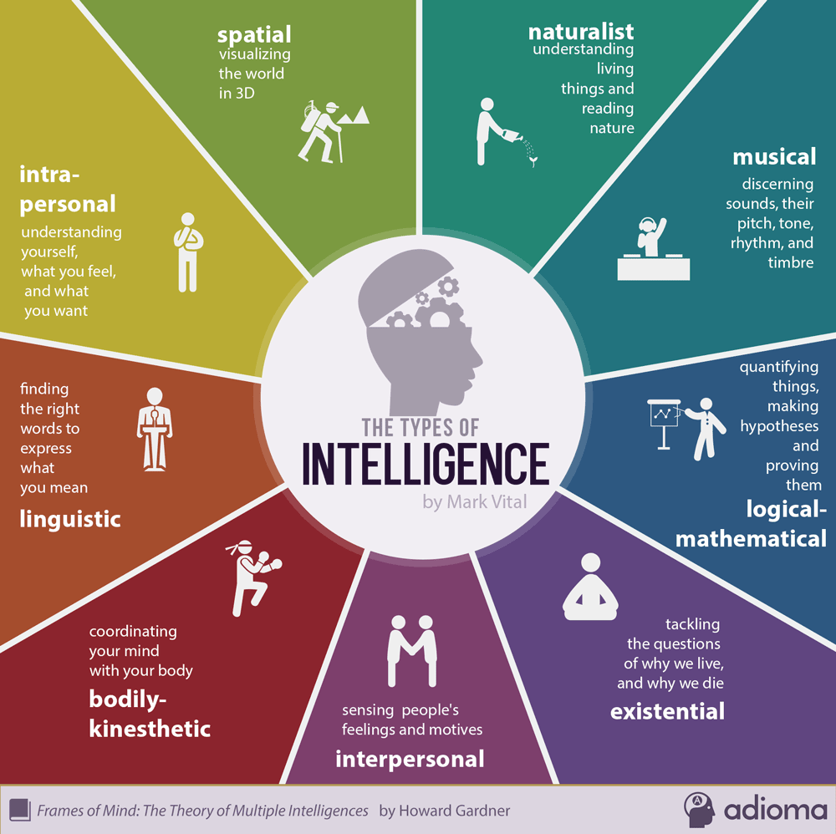
Theory of the 9 intelligences
Which are promoted by traditional education?
Which are ignored?
How can we find a better balance?

Slide 3
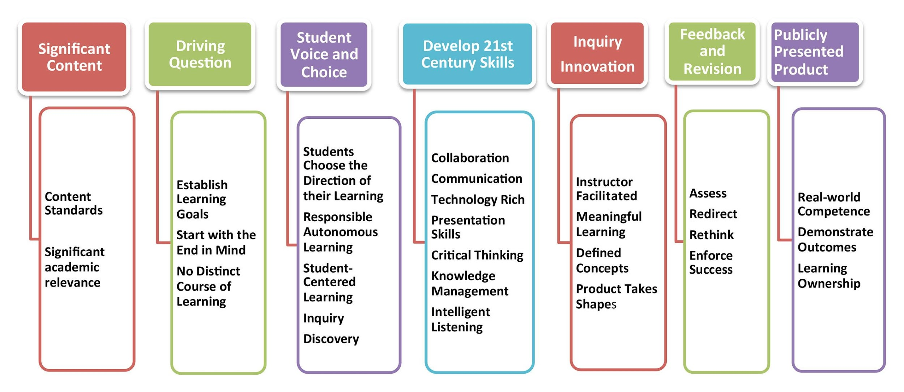
Project-Based Learning and objectives

Slide 4
How does it work in a culture (ROML 63) or language course (SPAN 321)?
“Students work on a project over an extended period of time that engages them in solving a real-world problem or answering a complex question. They demonstrate their knowledge and skills by creating a public product or presentation for a real audience.”
Extended period of time: students work on the project step by step throughout the semester
A real-world problem: the lack of personalized resources for an optimum experience of the Camino de Santiago (ROML 63) / the lack of accurate, easily accessible, and understandable information about health care IN SPANISH (SPAN 321)
Answering a complex question: how can we create a more meaningful experience of the Camino de Santiago for a pilgrim that has a specific interest or need (ROML 63)? how can we provide accurate, easy to understand, and accessible medical information in Spanish (SPAN 321)
Public product or presentation for a real audience: the project developed by each group will be created using readily available technology, it will be presented to the class, and could be made available for use to a real-life use (a pilgrim / a Hispanic person in the US)

Slide 5
The process
Step 1: Individual research
Step 2: The proposal
Step 3: The script (first draft)
Step 4: The final script, with story board
Step 5: The final product and presentation

Slide 6
conclusion
Exploration of a previously unknow topic of interest from a multidisciplinary perspective
Taking ownership of the learning process
Transcendence and relevancy of project
Motivation to explore further

