Slide 1
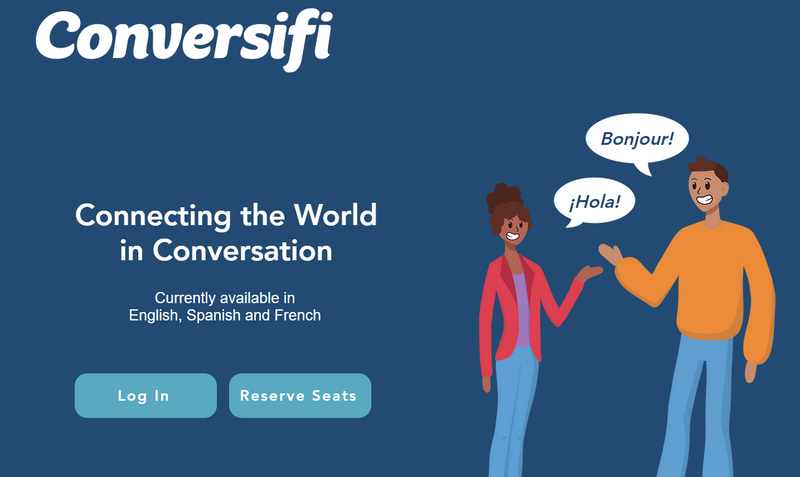
Conversifi Pilot SPAN 203
Fall 2019
https://www.conversifi.com/

Slide 2
Conversifi
Cost: $14.50 base subscription, then students can either pay for or earn tokens to use to have conversations with students who are native speakers and who serve as coaches.
Our students earn tokens by coaching other students in English through the app. Some students really enjoyed coaching others in their English and were amazed at how proficient their “clients” were in English. Some students preferred to pay for tokens and not coach.
Conversations are 15 minutes long. They can be tailored to the units of study for your course, or they can be “freestyle”. Many students in my class mentioned enjoying the freestyle conversations more than the themed ones.

Slide 3
Some students’ reactions
TW: “I think that this was overall a very good experience as I not only got to expand my vocabulary and knowledge on a different language, but I also got to come out of my bubble and talk to people that I did not know, which is something I rarely do. I got to learn a variety of different things about different countries from the perspective of the people who are in those countries rather than just reading about it.”
CW: “My favorite part about Conversifi was in the conversation with a 19 year old girl from Mexico and we were talking about things we enjoy to do for fun. It was neat to be able to have a “normal” conversation with her through Conversifi similar to a conversation I would have with another student at UNC if I were meeting them for the first time.”
AG: “I enjoyed seeing and interacting with Native-Spanish-speakers because it made decreased my anxiety. I was anxious to speak to a Native-Spanish-speaker because I was worried about what they would think about my conversational skills, and being able to see their reactions helped build my confidence. (They were kind and were not rude or openly displeased with my conversational ability)”

Slide 4
Pros Cons
Affordable base price
Token economy
Peer interaction
Opportunity for service and income
Company willing to tailor to your needs in terms of themes
Can do as many sessions as they want (provided they have enough tokens)
Some students don’t have time to coach and so have to pay for tokens.
Tech and logistical issues (although this has greatly improved).
Peer coaches are not formally trained and so not always effective.
While it is good to push students out of their comfort zone, for some, this was a really taxing experience. But most of my students said that it was worth it, even though they were very nervous.

Slide 5
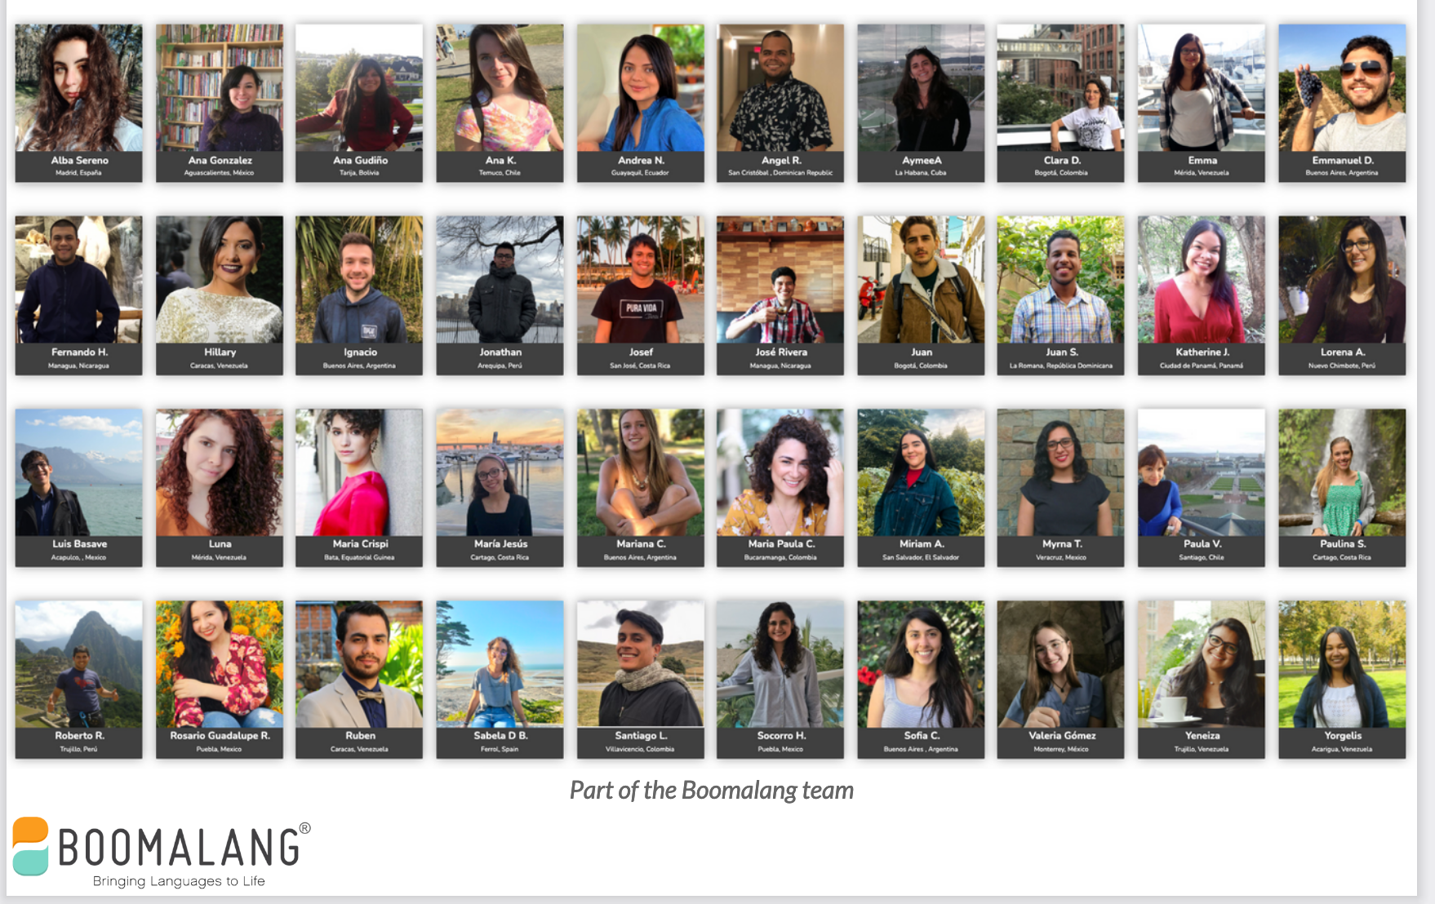

Slide 7
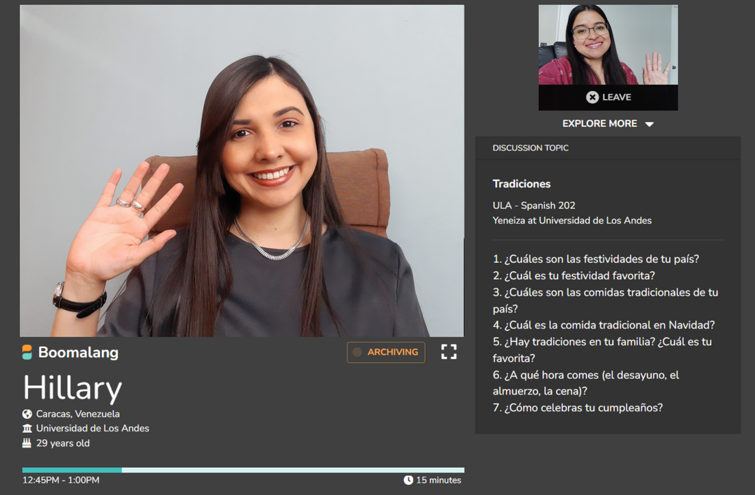
What is Boomalang?
Secure, intuitive video platform
Audio is recorded
15-min. or 30-min. conversations
Native speakers recruited from universities
Instructors can influence via Discussion topics

Slide 8
How do most schools implement Boomalang?
Most schools (especially beginner and intermediate-level courses)...
Require three to six, 15-min. conversations per term.
Assign conversation #1 in week 2 or 3 of the term, then evenly spread across the semester with a final conversation due towards the term's end.
Choose Discussion Topics per conversation from the recommended list (attached separately), write their own in a similar format or assign students to write a set of questions related to their textbook chapter topic.
Ask their students to bring 2-3 questions of their own, related to the Discuss Topics you've included.
Grade for participation to keep student anxiety low, then assign written reflections or presentations after students listen back to their recording (often then graded separately).
Allow students to select the same speaker or different speakers for each conversation; whichever makes the student more comfortable and engaged.

Slide 9
Dr. Cristina Carrasco, UNC - Chapel Hill SPA 203 - Intermediate Spanish
Using Boomalang as a cultural project
3% of final grade
Instructions:
"For your cultural project you will have four conversations with native speakers in Boomalang. Before each 15 min. conversation, you will write ten questions in Spanish related to the topics covered in class. You need to turn in those questions to your instructor before every conversation. When you meet your “native speaker partner” you can talk about whatever you want to but having those sample questions will help a lot to break the ice!!"

Slide 10
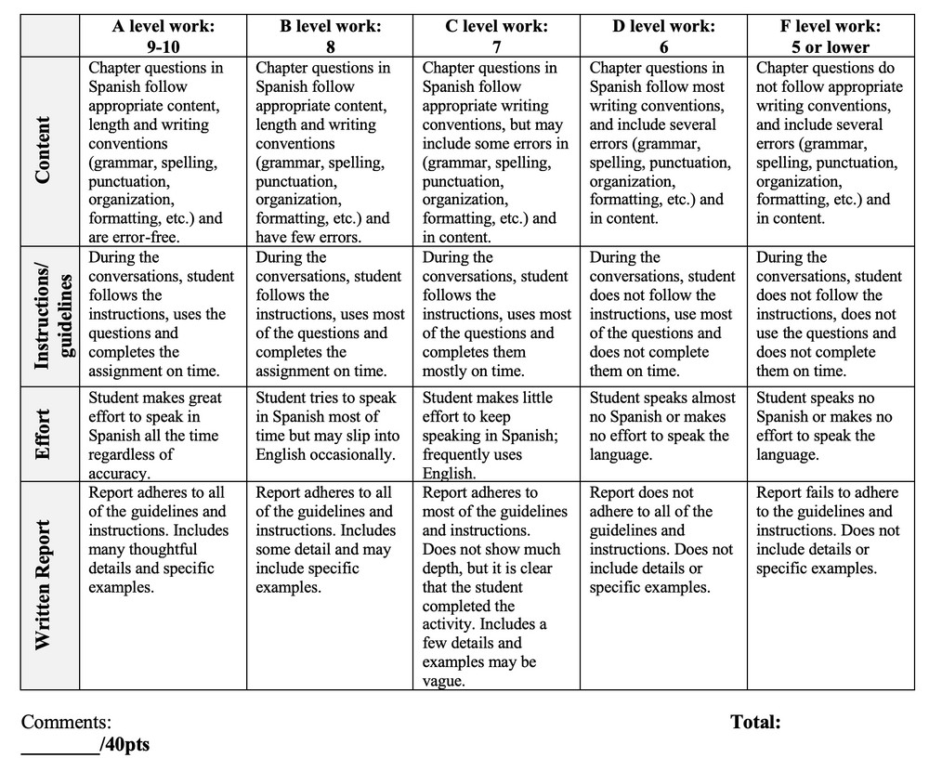
RUBRIC

Slide 11
WHAT ARE STUDENTS SAYING?
“My final conversation was my favorite. I had the most
confidence by the time I had this conversation, so
talking came much easier to me. I had a conversation
with a woman from Venezuela and she was only a few
years older than me so we had a lot in common. I
learned a lot about how they celebrate Christmas.”
“This cultural project was not only beneficial towards my
conversational skills in Spanish but it also widened my world
view. This also allowed for me to converse with native
speakers with different dialects than what I had heard in my
classes traditionally.”
_{“My favorite} thing was talking to people from different places and
learning about their different cultures. It helped me learn outside ^{the}
_{classroom,} so we could practice our Spanish more than just three days
a week.”

Slide 12
Pros Cons
Wide variety of native speakers
Speakers are trained and get paid to do the job
Great customer service
Students get to experience to have real authentic conversations in Spanish
Students learn first- hand about other cultures
It costs money (26$) per 3 (15m) conversations.
https://www.boomalang.co/#our-speakers

