Slide 1
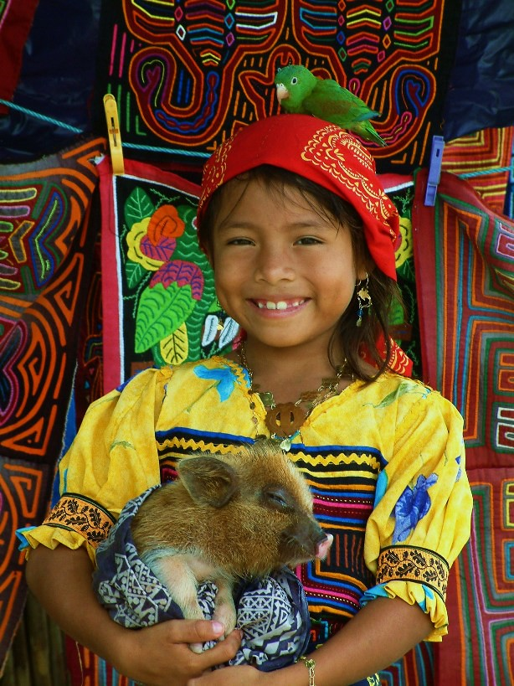
SPANISH MEETING
3/10/2021
MALGORZATA (Gosia) LEE
This Photo by Unknown Author is licensed under CC BY-SA-NC

Slide 2
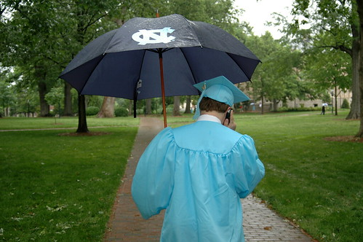
STATISTICAL DATA FOR SPRING 2021
Degree Candidates for 2021 Spring
22 (35 if HLG is included) majors are graduating
39 minors are graduating
1st majors HLC … 1 student
2nd majors HLC … 21 students
1st majors HLG … 6 students
2nd majors HLG … 7 students
1st minor Hispanic Studies … 31 students
2nd minor Hispanic Studies … 8 students
This Photo by Unknown Author is licensed under CC BY-SA-NC

Slide 3
Data majors/minors SPRING 2021 vs 2020
Span Major Minor 2021
TOTAL MAJORS: 67 (-24)
TOTAL MINORS: 116 (-48)
22-35 MAJORS & 39 MINORS GRADUATE IN MAY 2021
1st majors HLC … 13 students
2nd majors HLC … 54 students
1st minor Hispanic Studies … 98 students
2nd minor Hispanic Studies … 18 students
Span Major Minor 2020
TOTAL MAJORS: 91
TOTAL MINORS 164
1st majors HLC … 18 students
2nd majors HLC … 73 students
1st majors HLG … 33 students
2nd majors HLG … 49 students
1st minor Hispanic Studies … 148 students
2nd minor Hispanic Studies … 16 students

Slide 4
Hispanic Literatures & Cultures
Major Pathway
Gateway Course: SPAN 261 (SPAN 267 for Heritage speakers)
SPAN 301 (SPAN 302 for Heritage speakers)
2 cultural diversity courses
2 literature courses
3 specialized courses in language or literature

Slide 5
Hispanic Studies
Minor Pathway
Prerequisite: SPAN 261 (SPAN 267 for Heritage speakers)
SPAN 300 or 301 (302 for Heritage speakers)
Four courses numbered above SPAN 330, excluding SPAN 401, SPAN 402, SPAN 404, SPAN 405, SPAN 601

Slide 6
QUESTIONS TO PONDER
1. Span 300 on our website (in the overview for the Hispanic Minor)
Span 300 counts for the Hispanic Minor, however the ONLY version of it that exists NOW is a Linguistic version only.
DO WE WANT HLC MINORS TO TAKE THIS VERSION?
should we count it, leave it as such or just have Span 301/302 ONLY TO count as one of the 5 classes?
This Photo by Unknown Author is licensed under CC BY-NC

Slide 7
SPAN 300. Spanish Composition and Grammar Review. 3 Credits. CATALOGUE DESCRIPTION IS GENERIC
Advanced grammar and composition designed to improve grammatical analysis, accuracy, and develop writing skills, using process and task-oriented approaches. Honors version available Requisites: Prerequisite, SPAN 261 or SPAN 267; permission of the instructor for students lacking the prerequisite. Grading status: Letter grade.

Slide 8
QUESTIONS TO PONDER
2. For the Welcome to Carolina of new students' events, could we contact the Admissions office to include us with STEM people to broaden our exposure to newcomers?
Stem & language pairing would benefit us more (than hass (HUMANITIES AND ARTS AND SCIENCES) and language)
We used to do it like this in the past (in Alumni Center during morning times when over 200 students were present) and later the Admissions put us during lunch time and our numbers dwindled to like 3 THAT WOULD VISIT OUR PANEL!!!

Slide 9
QUESTIONS TO PONDER 3. RENAMING SOME COURSES TO MAKE THEM MORE APPEALING IN TITLES AND CONTENT- NEW MARKETING STRATEGY
SPAN 301. Introduction to Literary and Cultural Analysis. 3 Credits.
Prepares students to formulate and communicate critical analyses of literary works in at least three genres chosen from theater, poetry, essay, narrative, and film while situating the readings within a cultural context. Students will improve Spanish language proficiency and appreciation of different world views through literature and culture. Previously offered as SPAN 260. Students may not receive credit for both SPAN 301 and SPAN 260 or 302. Honors version available Requisites: Prerequisite, SPAN 261 or SPAN 267. Gen Ed: LA. Grading status: Letter grade.

Slide 10
4. RENAMING COURSES FOR HERITAGE LEARNERS ELLEN HAS CREATED NEW HERITAGE LEARNERS COMMITTEE & COLLABORATION WITH OTHER DEPTS.
SPAN 302. Literary and Cultural Analysis for Heritage Learners. 3 Credits.
Designed for heritage learners, prepares students to formulate and communicate critical analyses of literary works in at least three genres chosen from theater, poetry, essay, narrative, and film while situating the readings within a cultural context. Students will gain appreciation of different world views through literature and culture. Previously offered as SPAN 262; students may not receive credit for SPAN 302 and 260 or 301. Requisites: Prerequisite, SPAN 261 or 267; permission of the instructor for students lacking the prerequisite. Gen Ed: LA. Grading status: Letter grade.

Slide 11
QUESTIONS TO PONDER 5. Early advertisement VIA ZOOM-DUE TO PANDEMIA (SAMPLE SPAN 204 ADS FOR SPAN 261-MULTIPLE TIMES AS AD)

Slide 12
6. Digital ads/MORE ADS ON OUR DEPARTMENTAL WEBSITE/MAYBE SHORT MOVIES/PPTS ETC.
We lost our tv ads in dey hall due to THE pandemia, we need TO SUB IT WITH digital versionS to reach out to broader audiences: social media, Instagram.
IN SPAN 204 AD FOR 261/255
IN 261 AD FOR 301
IN 301 AD FOR ALL OTHER COURSES TO PRESENT MAJOR POSSIBILITIES MORE

Slide 13
QUESTIONS TO PONDER
7. DISTRIBUTE OUR MAJOR/MINOR WORSKEETS TO STEELE VIA DIGITAL FORMS AND ASK THE ADVISORS TO SHARE THEM WITH STUDENTS
SAMPLE WORKSHEETS NEXT SLIDE
8. DISTRIBUTE OUR MAJORS ONE PAGE FLYERS (CREATE NEW ONES?)

Slide 15
WHAT WE ARE DOING SO FAR?
PARTICIPATING IN ADMITTED STUDENT FAIR
ADVERTISING CLASSES VIA POSTED ADS IN ANNOUNCEMENTS IN SAKAI
ADVISING ABOUT MAJORS AND ENCOURAGING HERITAGE LEARNERS TO DO DOUBLE MAJORS

Slide 16
SAMPLE: ADMITTED STUDENT FAIR
PPT & VIDEO CREATION BY ADVISORS
LAST YEAR VIA ZOOM IT WAS NOT VERY EFFECTIVE (ONLY A FEW STUDENTS SHOWED UP -5 FOR SPANISH)
NEXT SLIDES SOME SAMPLE INFO. FROM THIS VIDEO/PPT PRESENTATION

Slide 17
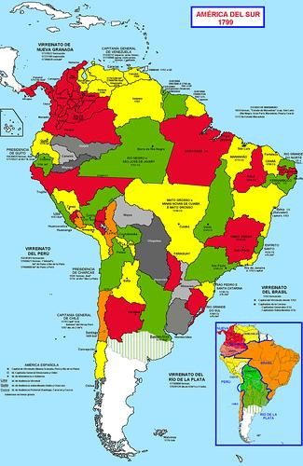
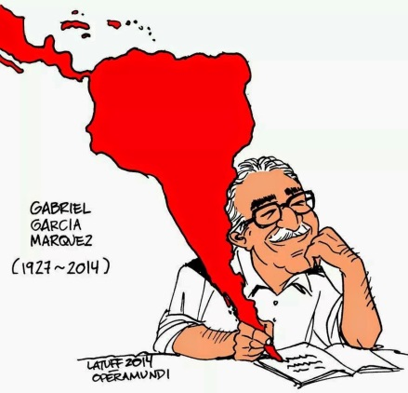
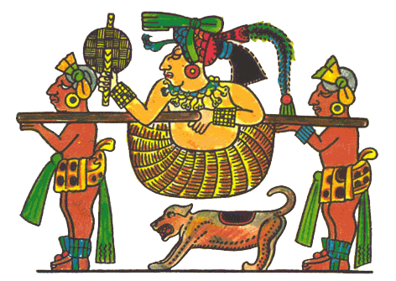
HISPANIC LITERATURES AND CULTURES MAJOR
Span 261 (gateway) or Span 267 for (heritage speakers)
8 COURSES CHOSEN FROM THE FOLLOWING:
Span 301
Two of the following: 371, 373
Two of the following: 338, 340, 344
Four additional courses
(NOTE: 401, 402, 404, 405, 601 & 602 do not count for a major) NOT taken before.

Slide 18
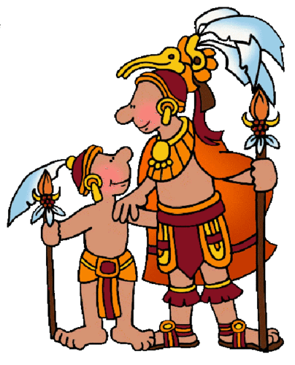
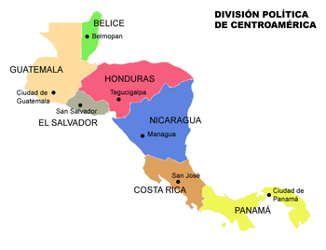
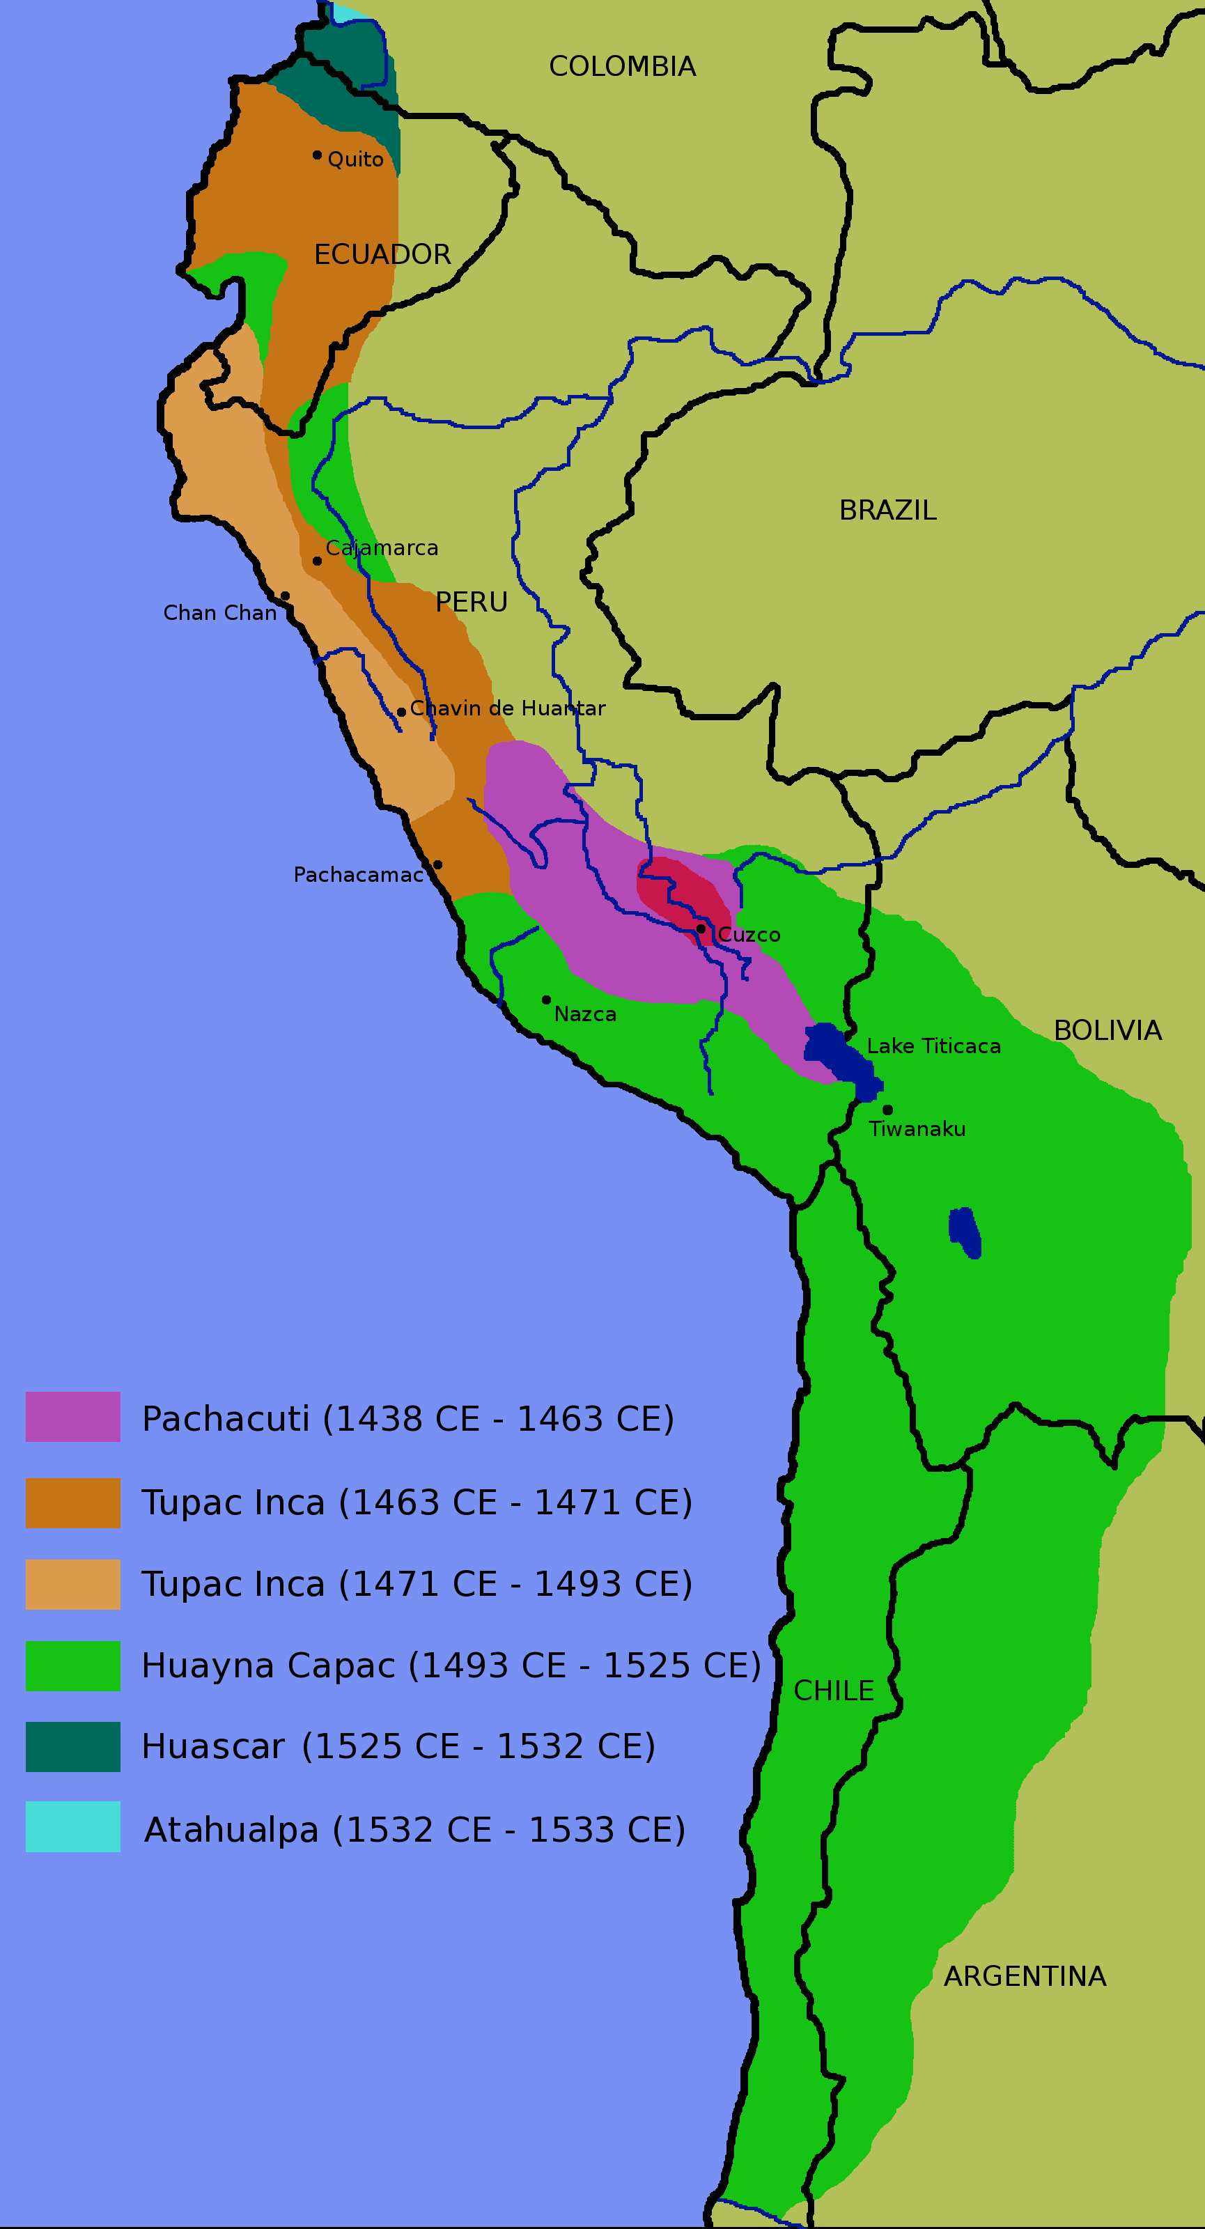
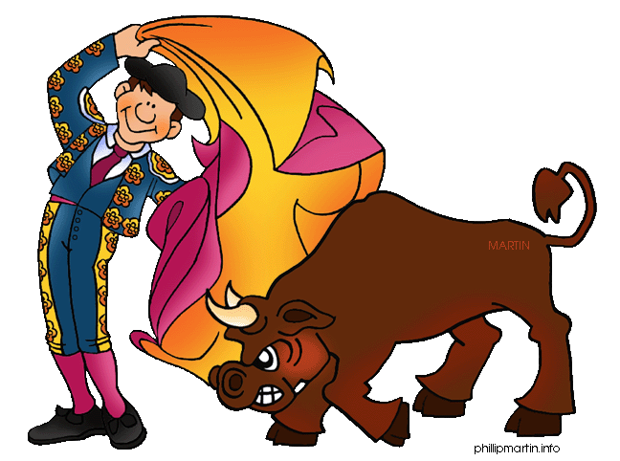
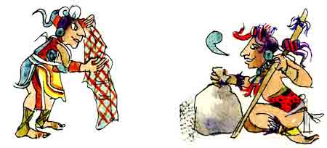
HISPANIC STUDIES MINOR
Span 261 or Span 267 for (heritage speakers)
Span 301 or 300
4 courses of 330 or above
(except: 401, 402, 404, 405 and 601)

Slide 19
WE COULD EMAIL CLASSES WE OFFER FOR THE MAJOR TO LISTERVS AND OR SPECIFIC GROUPS/CLASSES or set up a more visually appealing platform… (nefi is getting a new platform this summer)
https://catalog.unc.edu/undergraduate/programs-study/romance-languages-major-ba-hispanic-literatures-cultures/#requirementstext

Slide 20
EMAIL TO MINORS: MINOR IN HISPANIC STUDIES
https://catalog.unc.edu/undergraduate/programs-study/hispanic-studies-minor/#requirementstext

Slide 21
TARGET DOUBLE MAJORS (ALICIA & ROSA’S PROJECT) Which majors take Spanish majors?
Archaeology Minor
Biology Minor
Business Administration Minor
Chemistry Minor
Comp, Rhet, & Digital Lit Minor
Creative Writing Minor
Environ Sci & Studies Minor
Food Studies Minor
Global Cinema Minor
History Minor
Health and Society Minor
Marine Sciences Minor
Military Sci. & Leader. Minor
Neuroscience Minor
Social & Econ Justice Minor
Spanish for the Prof Minor
Statistics and Analytics Minor
Translation & Interpreting Min
Urban Studies & Planning Minor
Women's and Gender Studies Mnr

Slide 22
conclusions how to increase major numbers
This Photo by Unknown Author is licensed under CC BY-SA
Target second majors for spanish (rosa & Alicia project)
Early advertisement in the career: alumni center presentations, steele general advising rep./handouts or HAVE A POSITION OF a specific Spanish advisor
Span 204 in class presentations of programs we have (class visits VIA ZOOM)
Early span 261 advertisement to attract more students in general (hÉlÈne’s ad to span 204)
Get closer with stem majors (those programs have more money)
Create more study abroad programs just for majors (jo & abel)

